Slide 1
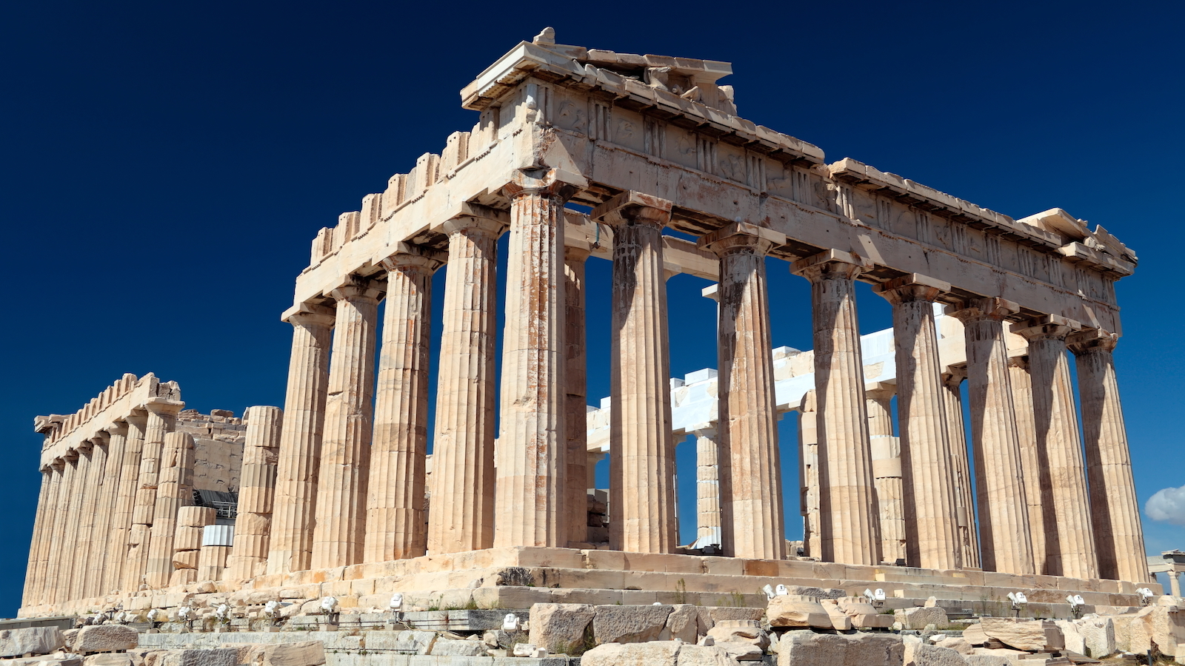
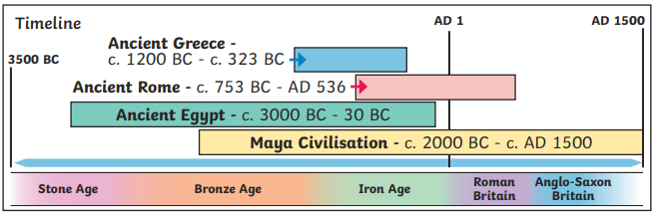
Knowledge organiser
Ancient Greece
Wider World

Slide 2
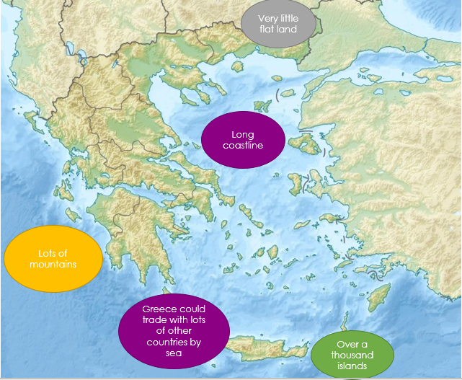
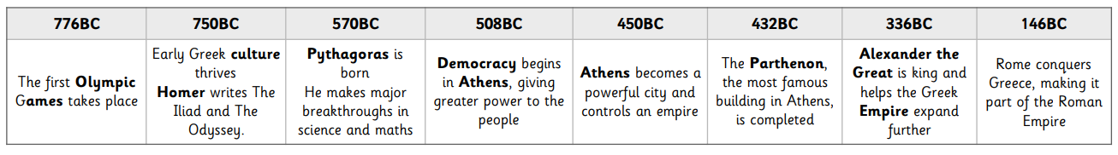
Ancient Greece
Why this period is important
Religion was very important in Ancient Greece. They were polytheists - they believed in different gods and goddesses that were in charge of different parts of their lives, such as a god of the sea and a goddess of wisdom. Temples were built in their honour and they featured heavily in the stories of Greek mythology. In Athens, Greek styles of art, architecture, philosophy and theatre were developed - these helped shaped our modern society along with science, language and maths. Athens had a democratic government – this means that the people who lived there made decisions by voting, like we do in Britain. In Sparta, life was very different; all that was important was being able to defend Sparta in battle.

Slide 3
Ancient Greece
Key vocabulary
Websites
KS2 History: Once upon a time in Ancient Greece - BBC Teach
https://www.mysteriesintime.co.uk/ancient-greece-for-kids http://www.primaryhomeworkhelp.co.uk/Greece.html https://www.bbc.co.uk/bitesize/topics/z87tn39
KQ6
In what ways have the Ancient Greeks influenced our lives today?
KQ1
When did the Ancient Greek civilisation begin and how long did it last?
Amphitheatre | An open circular or oval building with a central space surrounded by tiers of seats for spectators.
Athens | A powerful Greek city and where Democracy was born.
BC | Before Christ. A way of dating years before the birth of Jesus. The bigger the number BC, the longer ago in history it was.
Civilisation | A human society with its own social organisation and culture.
Democracy | A democracy means ‘rule by the people’. Here, people can take part in the decisions that affect the way their community is run.
Empire | Many countries that are ruled by one leader.
Myth | Stories about gods and monsters and sometimes explaining how the world works.
Olympics | A sporting event held by the Ancient Greeks every four years.
Parthenon | A temple built to worship the Greek Goddess Athena.
Polytheist | The worship of or belief in more than one god.
Society | A community of people living together and having shared ways of living.
Sparta | A power Greek city-state and rival to Athens, Sparta's culture was based around warfare and preparing for battle.
KQ5
What can we tell about the Ancient Greeks from their interest in the theatre?
KQ2
What can we work out about everyday life in Ancient Athens from pottery remains?
Top takeaways
Having studied this topic you should be able to:
Sequence and place events from Ancient Greece on a timeline using dates.
Understand that much evidence comes from pottery and many pictures in books are scenes from sides of pots.
Understand how Gods and Goddesses influenced Ancient Greek life.
Understand why the Greeks held the Olympics.
Understand how theatres influenced Ancient Greek life.
List achievements of the Greeks and how they’re still relevant today.
KQ4
What can we tell about the Ancient Greeks from the Olympic Games?
KQ3
Who were the ancient Greek gods and heroes and how did they influence the lives of Ancient Greeks?
Books to read
-

