Slide 1
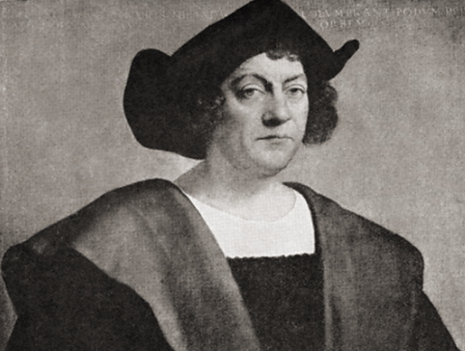
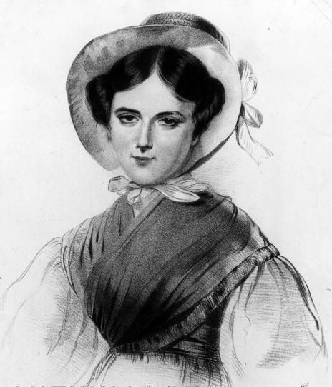
Knowledge organiser
Christopher Columbus and Grace Darling
Wider World

Slide 2
Christopher Columbus and Grace Darling
Why these significant individuals are important
Christopher Columbus was a sailor. His first voyage nearly ended in disaster as his ship was attacked and set on fire by pirates. Columbus only survived by swimming to land. He became famous as the explorer who found new lands called ‘The Americas’. But actually, many people already lived there.
Grace Darling is remembered for the rescue she undertook with her father in the Farne Islands in 1838. Grace and her father rowed to the rescue, bringing nine survivors who had been clinging to rocks safely back to Longstone Lighthouse. After the rescue Grace received awards for her bravery; she also became a national celebrity, with presents sent to her from well-wishers all across the country - including Queen Victoria herself.
1493 -1502
3 other voyages across Atlantic Ocean to Caribbean.
1825
The Darlings move to Longstone lighthouse.
1842
Grace Darling dies.
1938
Museum opened dedicated to Grace Darling.
1485
CC arrives in Spain.
1506
Christopher Columbus dies.
1400
1500
1600
1700
1800
1900
1451
Christopher Columbus is born.
1492
CC leaves Spain with 3 ships and sailed west.
12th October
He lands in Bahamas, North America.
1815
Grace Darling is born.
1880
‘Grace Darling: Her True Story’ is published.
September 1838
The SS Forfarshire crashes.
November 1838
Queen Victoria rewards Grace Darling.

Slide 3

Christopher Columbus and Grace Darling
Key vocabulary
Websites
Who was Christopher Columbus? - BBC Bitesize
Grace Darling - BBC Teach
KQ6
How did sea rescue improve as a result of Grace Darling’s story?
KQ1
How did Columbus become famous?
Continent | A large area of land that may be made up of several countries
Compass | An item used to show direction.
Explorer | A person who explores a new or unfamiliar area.
Famous | Someone who is known by many people.
Navigator | A person in a vehicle who decides the direction in which the vehicle travels
Ocean | One of the five large areas of sea on the earth’s surface.
Sailor | A person whose job it is to work as a member of the crew on a ship or boat.
Santa Maria | This was the largest of the ships used by Christopher Columbus in his first voyage across the Atlantic Ocean in 1492, the others being the Niña and the Pinta.
Voyage | Long journey involving travel by sea.
Heroine | A woman who has done something brave and who is admired by lots of people.
Lighthouse | A tower or other structure containing a beacon light to warn or guide ships at sea.
Rescue | Save someone from a dangerous or difficult situation.
Survivor | A person who survives, especially a person remaining alive after an event in which others have died.
KQ5
What did Grace do that made her famous and why is she remembered today so long afterwards?
KQ2
Why did Columbus risk his life to explore somewhere no one alive had ever seen?
Top takeaways
Having studied this topic you should be able to:
Explain how Columbus became famous.
Understand why Columbus did what he did
Talk about what life was life on a long journey back then.
Discuss different opinions and perspectives on Columbus.
Explain who Grace Darling is and why she is famous today.
Identify ways in which sea rescue has improved, comparing then and now.
KQ4
Did everyone think that Columbus was a hero?
KQ3
What was life like on board during such a long journey?
Books to read

