Slide 1
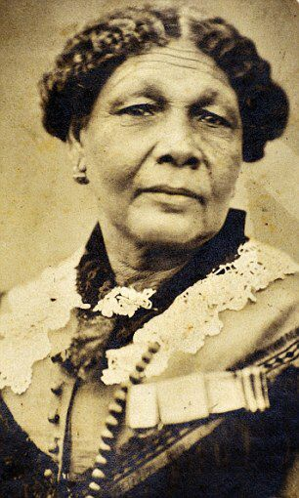
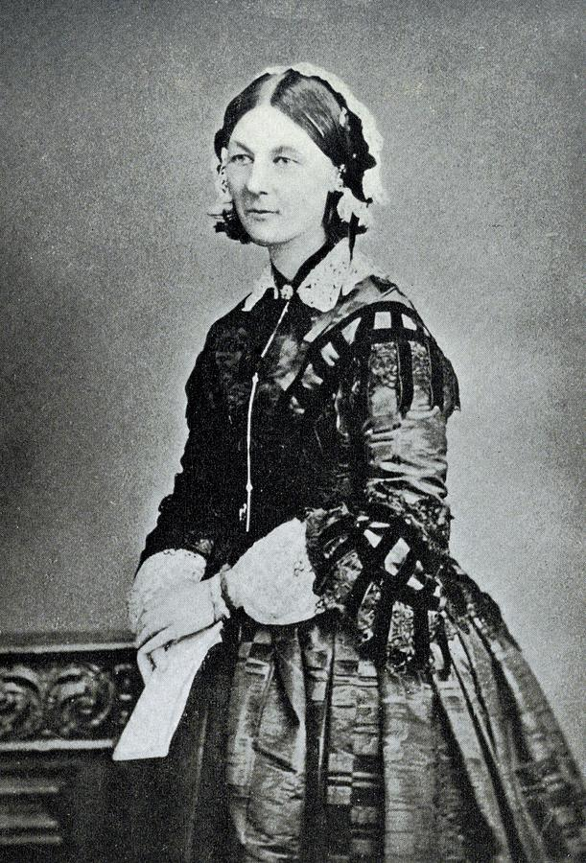
Knowledge organiser
Mary Seacole and Florence Nightingale
Wider World

Slide 2
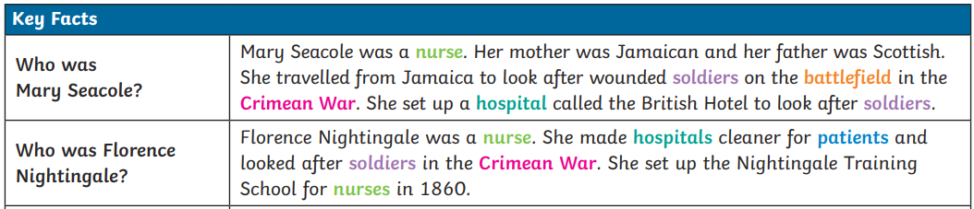
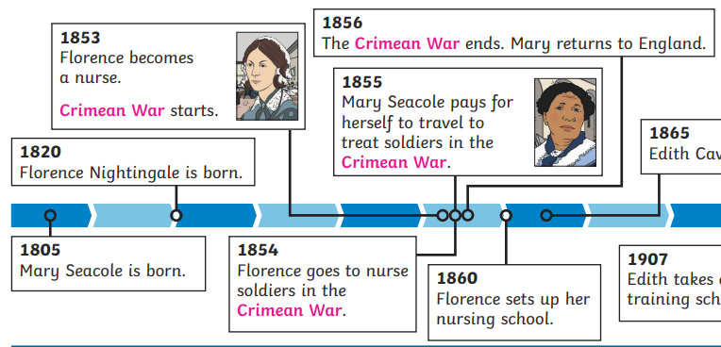
Mary Seacole and Florence Nightingale
Why these significant individuals are important
1881
Mary Seacole dies.
1910
Florence Nightingale dies.

Slide 3

Florence Nightingale and Mary Seacole
Key vocabulary
Websites
Famous nurses - Year 1/2 - P2/3 - History Collection - Home Learning with BBC Bitesize - BBC Bitesize
KQ6
Should Florence Nightingale rather than Mary Seacole have her statue at St. Thomas’ hospital?
KQ1
Why is Florence Nightingale remembered today and what did she do in her life?
Battlefield | A place where soldiers fight in war.
Courageous | Someone who is brave.
Crimean War | A war fought between Russia on one side, and France, the United Kingdom and Turkey on the other side.
Disease | A condition that causes harm to the health of a person, animal, or plant.
Hospital | A building where doctors and nurses take care of people who are ill or injured.
Infection | The act or process of passing on or introducing a germ, illness, or disease.
Medicine | Treatment taken by someone to help make them feel better.
Nurse | A person who is trained to care for sick or injured people and who usually works in a hospital or doctor's office.
Patients | People who are being looked after by nurses and doctors.
Soldier | A person who fights as party of an army when there is a war.
KQ5
How important was Mary’s work in the Crimean war and how do we know?
KQ2
Why did Florence place herself in such danger by going to the Crimea war?
Top takeaways
Having studied this topic you should be able to:
Understand what Florence Nightingale did in her life.
Understand what Florence did during the Crimean War.
Talk about how Florence improved the lives of soldiers during the Crimean war.
Identify significant moments of Mary Seacole’s life.
Understand how important Mary’s work was during the Crimean war.
Compare and contrast Mary and Florence’s role and share opinions.
KQ4
What did Mary Seacole do in her life and what were her most significant moments?
KQ3
What did Florence do to improve the lives of the soldiers when she arrived in the Crimea?
Books to read

