Slide 1
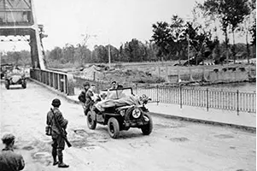
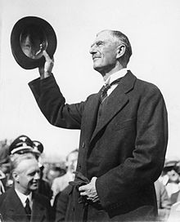
Knowledge organiser
A Child’s War
British History

Slide 2
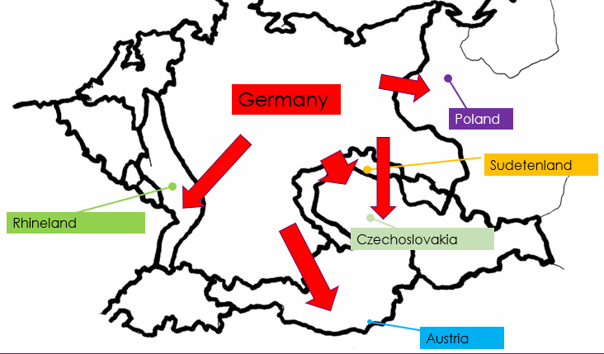
A Child’s War
Why this period is important
WW2 was a battle between two groups of countries – the allied powers and the axis powers. Together with the Nazi party, Hitler wanted Germany to rule Europe. To gain more land and power, on 1st September 1939 German troops invaded Poland. After Hitler refused to stop the invasion, Britain and France declared war on Germany – WW2 had begun. WW2 was one of the most destructive conflicts that the world has ever seen, and it had a huge impact on global politics and human society that is still being felt to this day. Learning about WW2 is very important for understanding the current politics of the world.
The Battle of Britain is considered by many to have been one of the most significant events of WW2. The Battle marked the first defeat of German forces, since Hitler had tried and failed to establish air superiority.
Europe 1938
Timeline of Events
11th November 1918 | Germany surrendered – end of World War 1.
1936 | German troops re-occupied the Rhineland (see map) against the Treaty of Versailles.
12th March, 1938 | Germany joined up with Austria, an act which was forbidden by the Treaty of Versailles.
March 1939 | German troops invaded Czechoslovakia.
1st September 1939 | German troops invaded Poland.
3rd September 1939 | Great Britain, France and their Allies declared war on Germany. World War 2 started.
April 1940 – June 1940 | Germany invaded European countries.
10th May 1940 | Winston Churchill elected Prime Minister of Great Britain
10th July – 31st October 1940 | The Battle of Britain – attacks on British towns, cities and ports by the German air force.
September 1940 – May 1941 | The Blitz attacks.
8th May 1945 | Victory Day in Europe (VE Day) – end of World War 2.

Slide 3
A Child’s War
Key vocabulary
Websites
World War Two - BBC Teach
World War 2 facts for kids | National Geographic Kids (natgeokids.com)
The Battle of Britain (primaryhomeworkhelp.co.uk)
VE Day: What is it, when is it and why do we remember? - CBBC Newsround
https://www.dkfindout.com/uk/history/world-war-ii/battle-britain/
KQ6
Why is it so difficult to be sure what life on the Home Front was really like?
KQ1
Why did Britain have to go to war in 1939?
Allies | Countries (including Britain, France, the Soviet Union and the USA) who fought the Axis Powers.
Appeasement | The way the British government dealt with Hitler’s Germany before the Second World War.
Axis | Germany, Japan, Italy and other countries that fought against the Allies.
Blitz | Attacked by bombs dropped by enemy aircraft.
Censorship | The examination of different forms of media and the suppression of parts considered unacceptable.
Evacuate | To send someone to a place of safety.
Evacuee | A person (usually a child) sent to a place of safety.
Home Front | The people who stay in their own country during a foreign war.
Invasion | When a foreign army enters a country by force.
Luftwaffe | German Air Force
Nazi party | A German political party led by Adolf Hitler.
Persecute | To treat someone unfairly or cruelly over a long period of time because of their race, religion, or political beliefs.
Propaganda | A form of communication to distribute information. It is always biased. The information is designed to make people feel a certain way or to believe a certain thing.
Rationing | A limited amount of food you were able to buy, used to make sure everyone had a fair share.
Treaty | A written agreement to do a particular thing, used at the end of the war to create peace.
KQ5
How did people manage to carry on normal life during the war and how do we know?
KQ2
Why was it necessary for children to be evacuated and what was it really like?
Top takeaways
Having studied this topic you should be able to:
Discuss key events that led to WW2 in 1939.
Give reasons for and against the appeasement of WW2.
Explain why people were evacuated.
Describe contrasting experiences of evacuees.
Explain why the Battle of Britain was a turning point during the war.
Identify how Britain stood strong against German invasion.
Describe roles adults played on the Home Front and explain how you know.
Use terms censorship and propaganda to discuss evidence left behind.
KQ4
How was Britain able to stand firm against the German threat?
KQ3
Why was the Battle of Britain a turning point during the war?
Books to read
World War II, by DK Find out!
World War II (Eyewitness) by DK Propaganda (At Home in World War Two), by Steward Ross
Investigating the Home Front 1939 -45, by The National Trust

